Slide 1

Let’s Talk
Electric Vehicles

Slide 2

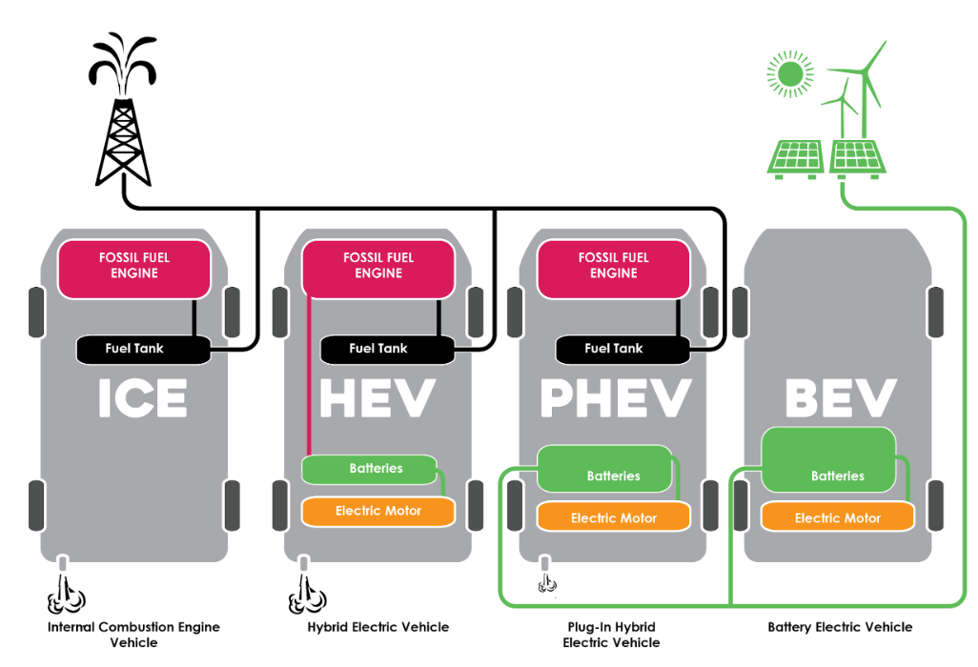

Electric Vehicle - EVs
Source: EV-comparisons.png (2500×1735) (thepowertrip.co.nz)
With support from

Slide 3

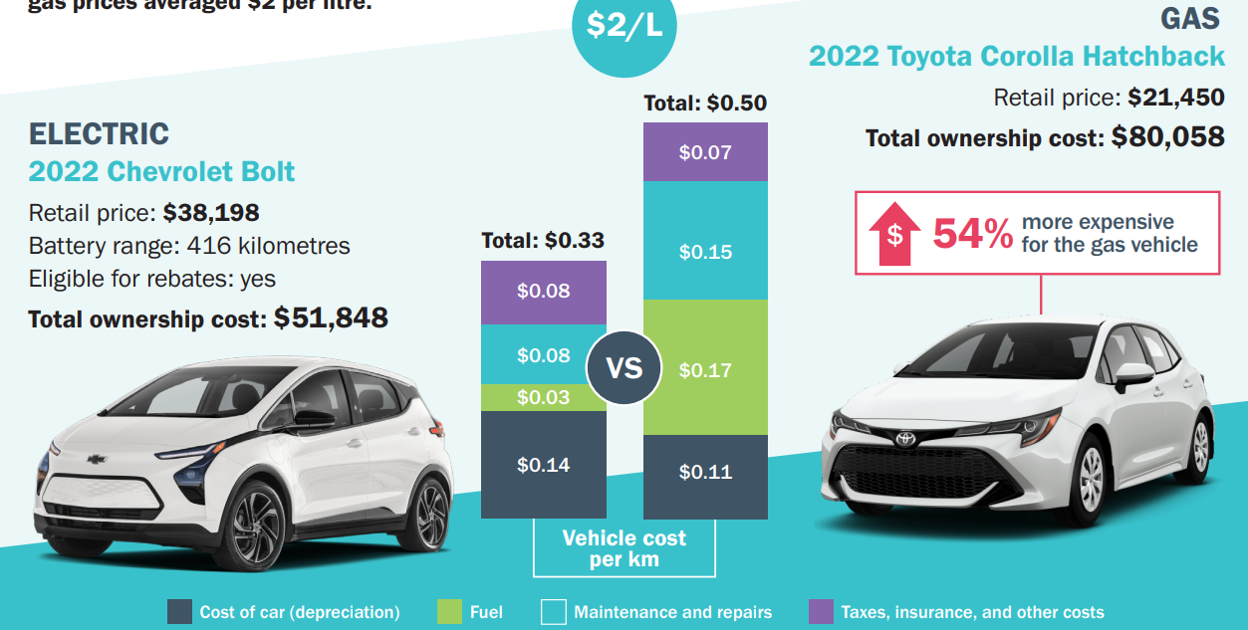
EV Vs Gasoline Vehicle – Charging Cost
Source: TheTrueCost.pdf (cleanenergycanada.org)
With support from

Slide 4
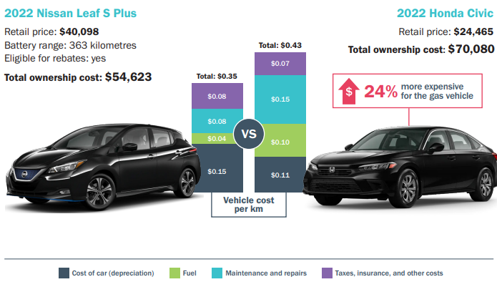
EV Vs Gasoline Vehicle: Total cost of Ownership
Source: TheTrueCost.pdf (cleanenergycanada.org)
With support from

Slide 5
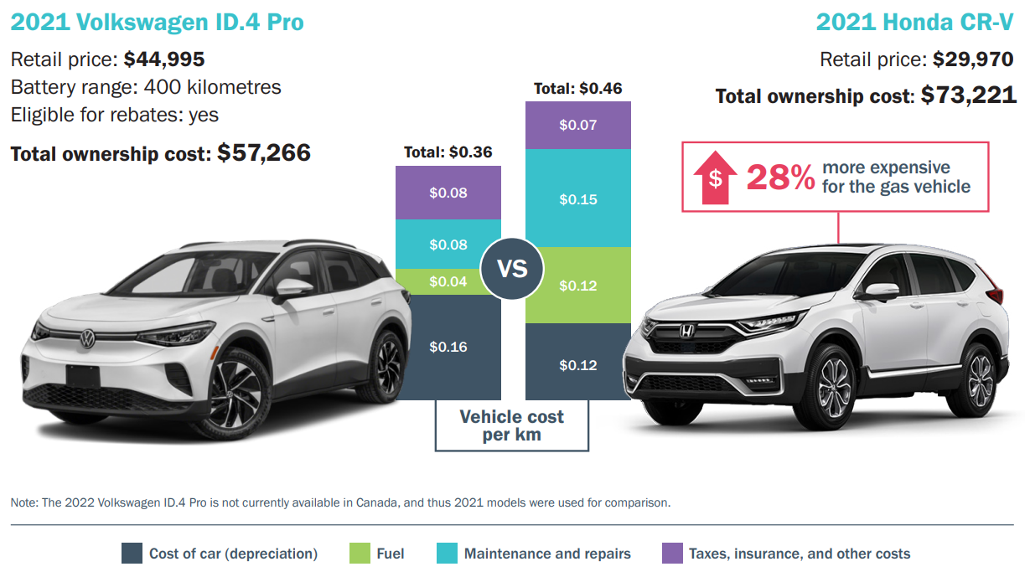
EV Vs Gasoline Vehicle: Total cost of Ownership
Source: TheTrueCost.pdf (cleanenergycanada.org)
With support from

Slide 6
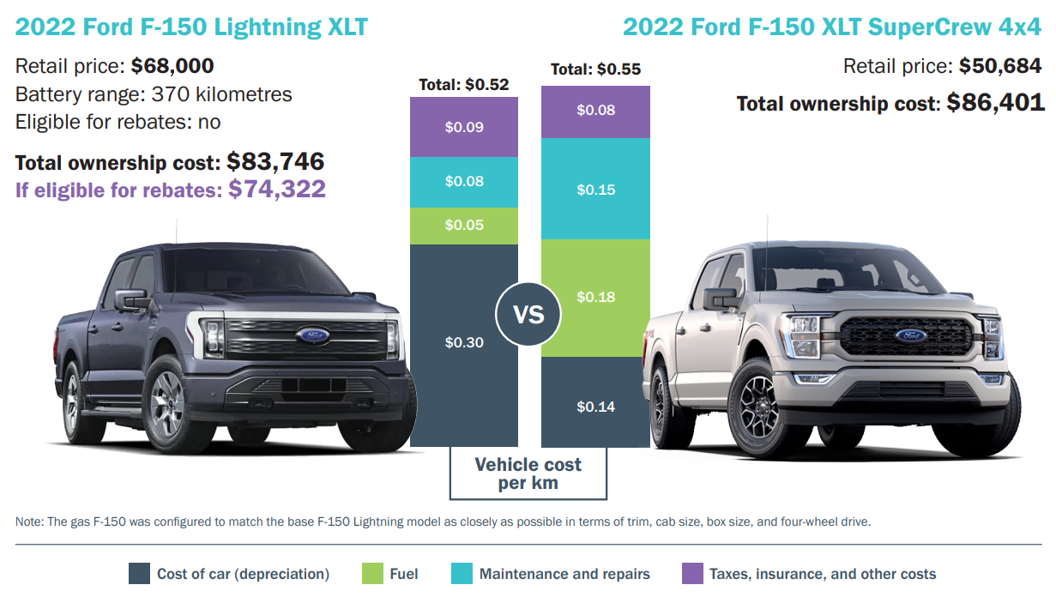
EV Vs Gasoline Vehicle: Total cost of Ownership
Source: TheTrueCost.pdf (cleanenergycanada.org)
With support from

Slide 7
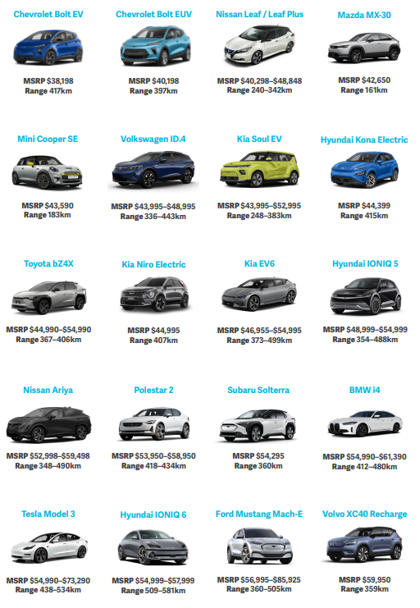
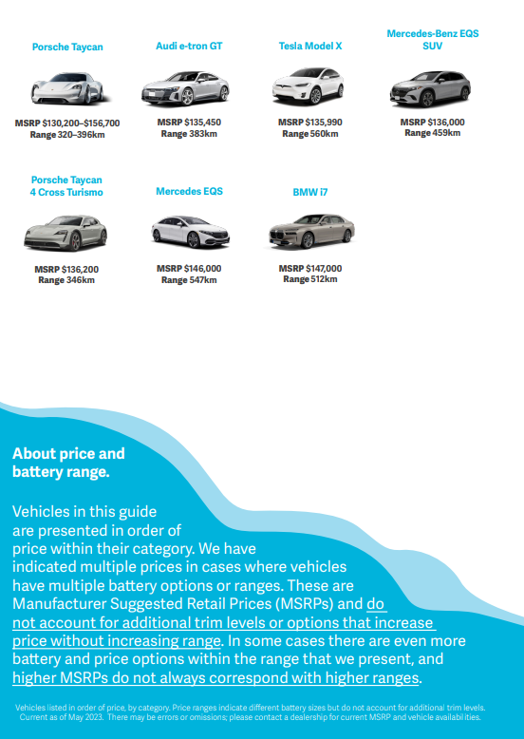
Available EVs In The Market
Source: TheTrueCost.pdf (cleanenergycanada.org)
With support from

Slide 8
RDOS corporate / community EV charging
Development of public EV charging infrastructure
  Installed 2 x DC Fast chargers in Naramata
  Installing 17 x level II chargers in various other locations
  Installing Keremeos and Penticton EV chargers
Conducted studies on EVs for RDOS corporate and public charging.
With support from

Slide 9
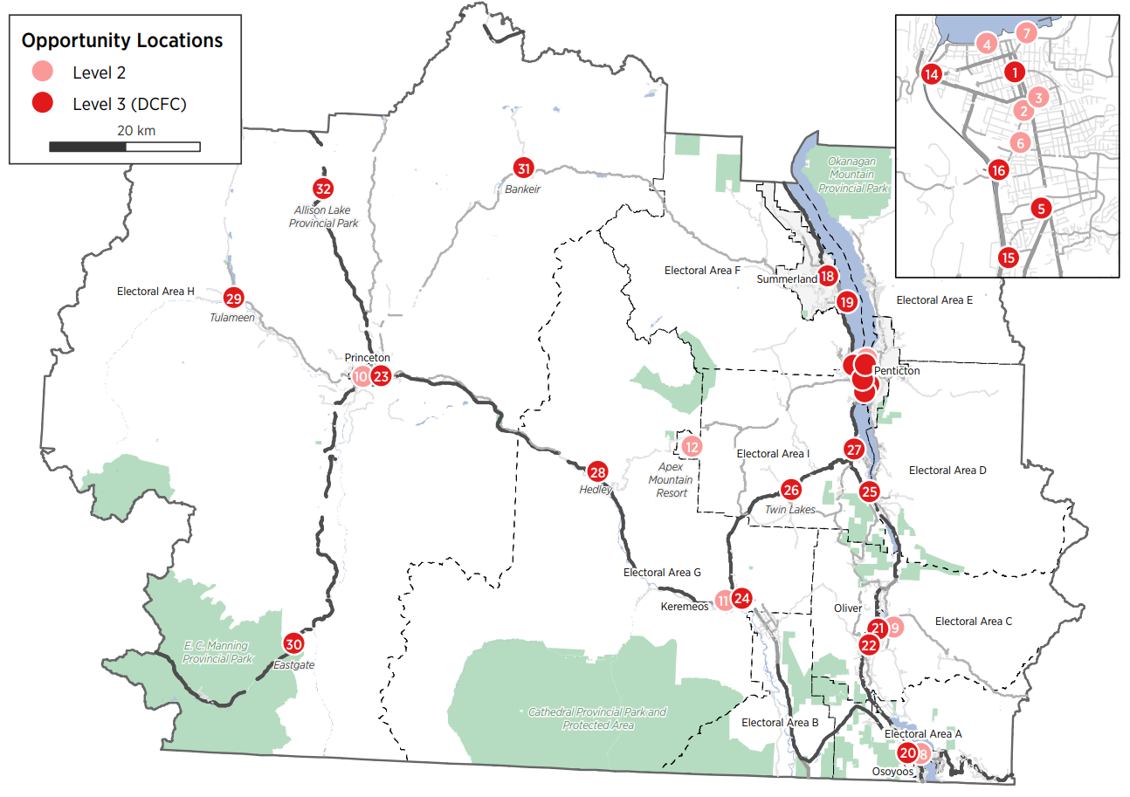
Gap Analysis - Identified possible locations
Public Charging Stations
Source: Gap Analysis Report, RDOS
With support from

