Slide 1
Draft Electoral Area “E”
Official Community Plan
Bylaw No. 3010
Summary of Significant Policy Changes
Community Advisory Group June 29, 2023

Slide 2
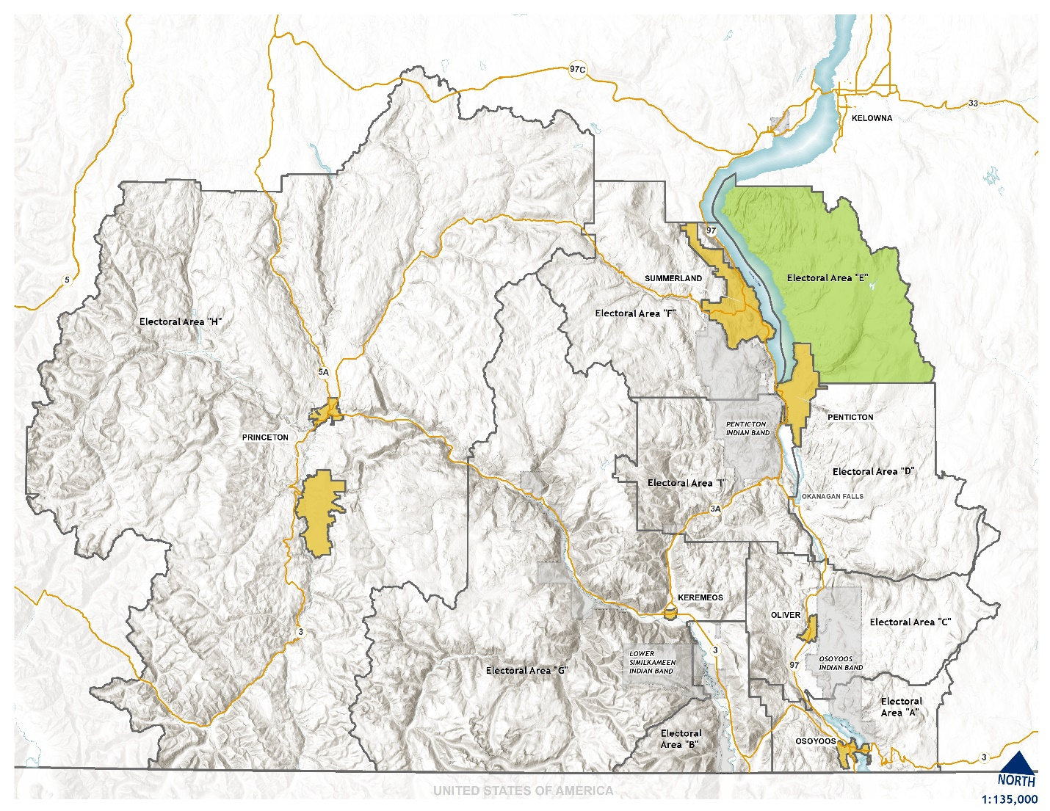
545 sq km (54,500 ha)
69.0% - Resource Area
18.2% - Parks, Recreation and Trails
1.8% - Agriculture
Population – 2015 (2021 Census)

Slide 3
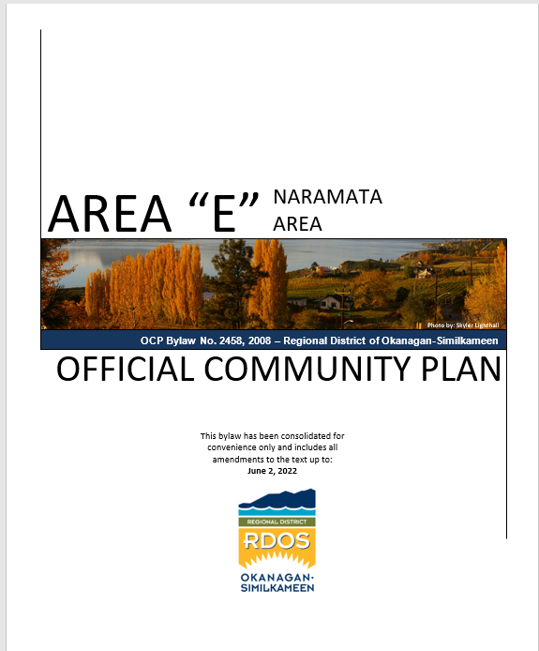
Electoral Area “E” draft OCP Bylaw
Current Electoral Area “E” OCP Bylaw was adopted in 2006;
Was “Repealed & Re-enacted” in 2008 largely unchanged;
Has been amended 40 times (+/-) since 2006;
Review of OCP was identified as a priority in 2020 Business Plan.

Slide 4
Electoral Area “E” draft OCP Bylaw
Background Context:
Since 2006, a number of “significant” changes have already been made to the Electoral Area “E” OCP, including:
  WDP Areas (2006)
  Climate Change & GHG reduction policies (2010)
  Vacation Rental policies (2014)
  ESPD Area Update (2017)
  Accessory dwellings update (2020)
  Cannabis production (2020)

Slide 5
A new OCP….challenges & opportunities
Regional considerations
Regional Growth Strategy
LWMP and proposed community sewer
Community desires / concerns
Changing character, or not?
Climate change adaptation and resilience
Engagement

Slide 6
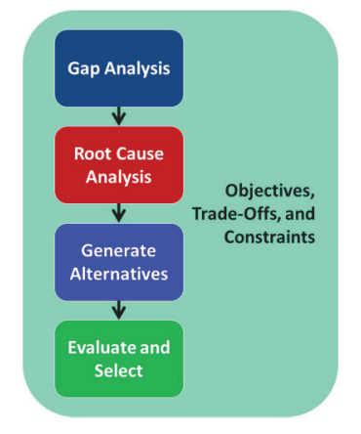
Electoral Area “E” draft OCP Bylaw - Process
In-House mostly
Initial Community Engagement completed by “LOCAL Decisions”
Community Advisory Group (not appointed)
Staff changes, Local Election pause
‘Community Conversations’

Slide 7

Electoral Area “E” draft OCP Bylaw
Community Engagement
Three-round survey, 2021/2022
Over 500 people participated
Trade-offs and compromises

Slide 8
Electoral Area “E” draft OCP Bylaw
Vision
Electoral Area “E” is a rural area made up of the Naramata village, surrounding farm land, and smaller residential neighbourhoods. Residents value the quiet rural character, sense of community, and proximity to nature.
Naramata village is a vibrant place with a diversity of families that supports year-round businesses and respects the history and quaint character of the area. The natural areas and farm lands are preserved through stewardship and public education.

Slide 9
Electoral Area “E” draft OCP Bylaw
Significant Policy OCP Changes
Community Profile
Growth Management
Local Area Policies
Resource Area
Administrative, Cultural and Institutional
Naramata Village Centre
Hazard Lands
Community Infrastructure
Climate Change and Adaptation
Subdivisions
No current subdivisions are impacted by proposed OCP Bylaw

Slide 10
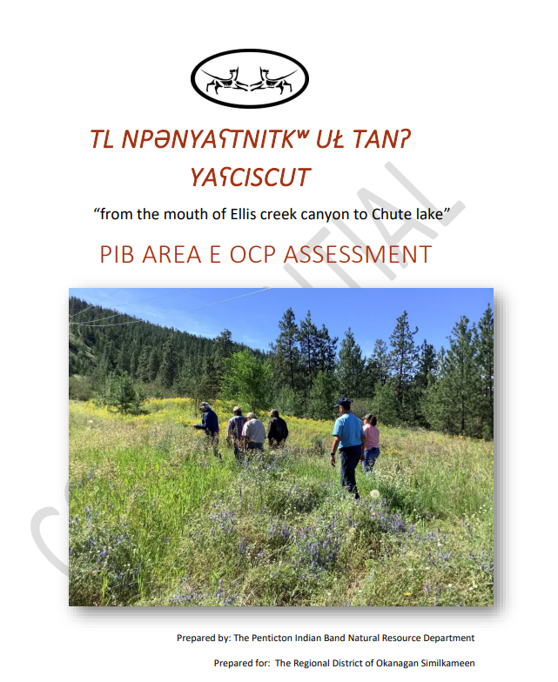
Community Profile
Expanded section including PIB Assessment
Updated demographic data
Updated Housing data

Slide 11
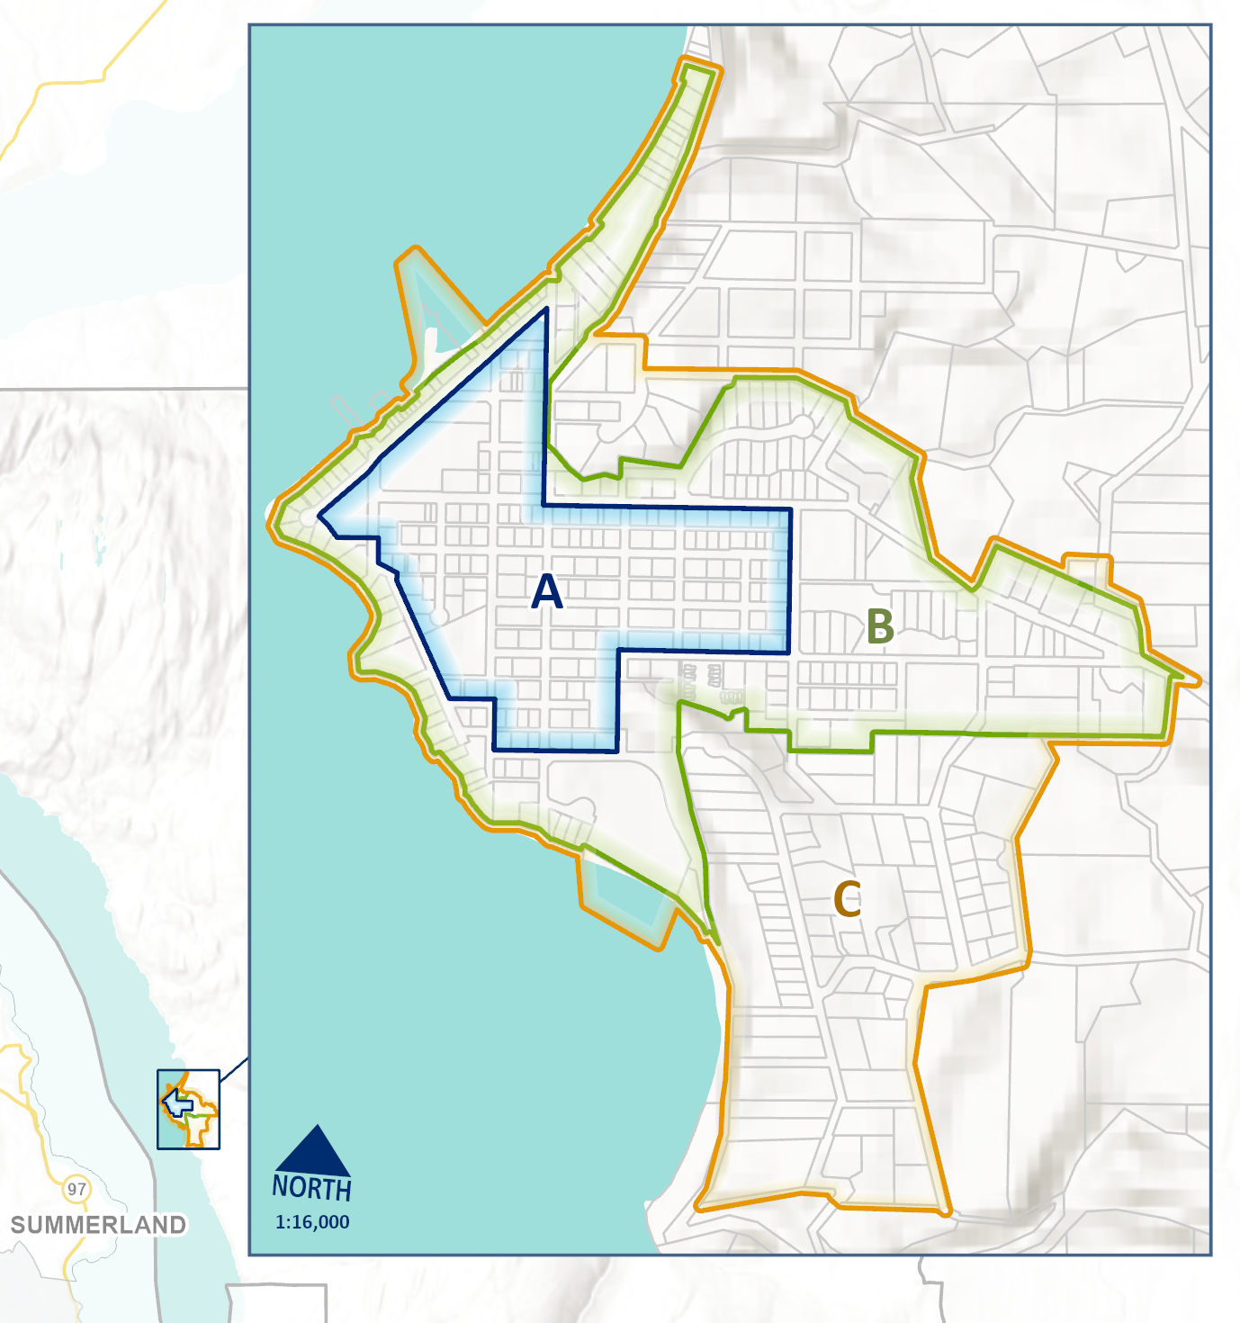
Growth Management
South Okanagan RGS Bylaw designates “Naramata” as Rural Growth Area
Proposing a layered approach with a series of growth containment boundaries

Slide 12
Growth Management
“A”- focusses commercial, mixed use, and some higher type of residential densities
“B”- short to mid term growth, similar to resident’s preference and to Phase 1 of LWMP
“C”- longer term (50 years~), similar to Phase 2 of LWMP

Slide 13
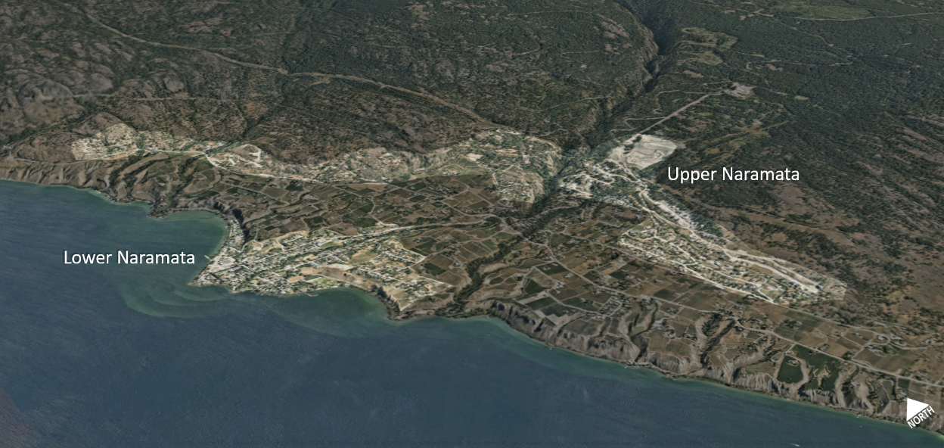
Local Area Policies
‘Lower’ Naramata & Upper Naramata
Separate policies
Also Falcon Ridge and Indian Rock

Slide 14
Local Area Policies
‘Lower’ Naramata
  Supports infill
  May consider re-designation of Naramata Centre lands to allow for mixed residential densities
  Supports a community sewer system
  Encourages MOTI to consider traffic calming and walking areas adjacent to roads
  Supports showcasing heritage values
Upper Naramata
  Discourages further rezoning for residential subdivision
  Encourages MOTI to review traffic movement and safety
  Will consider exploring options for regulating hillside development

Slide 15
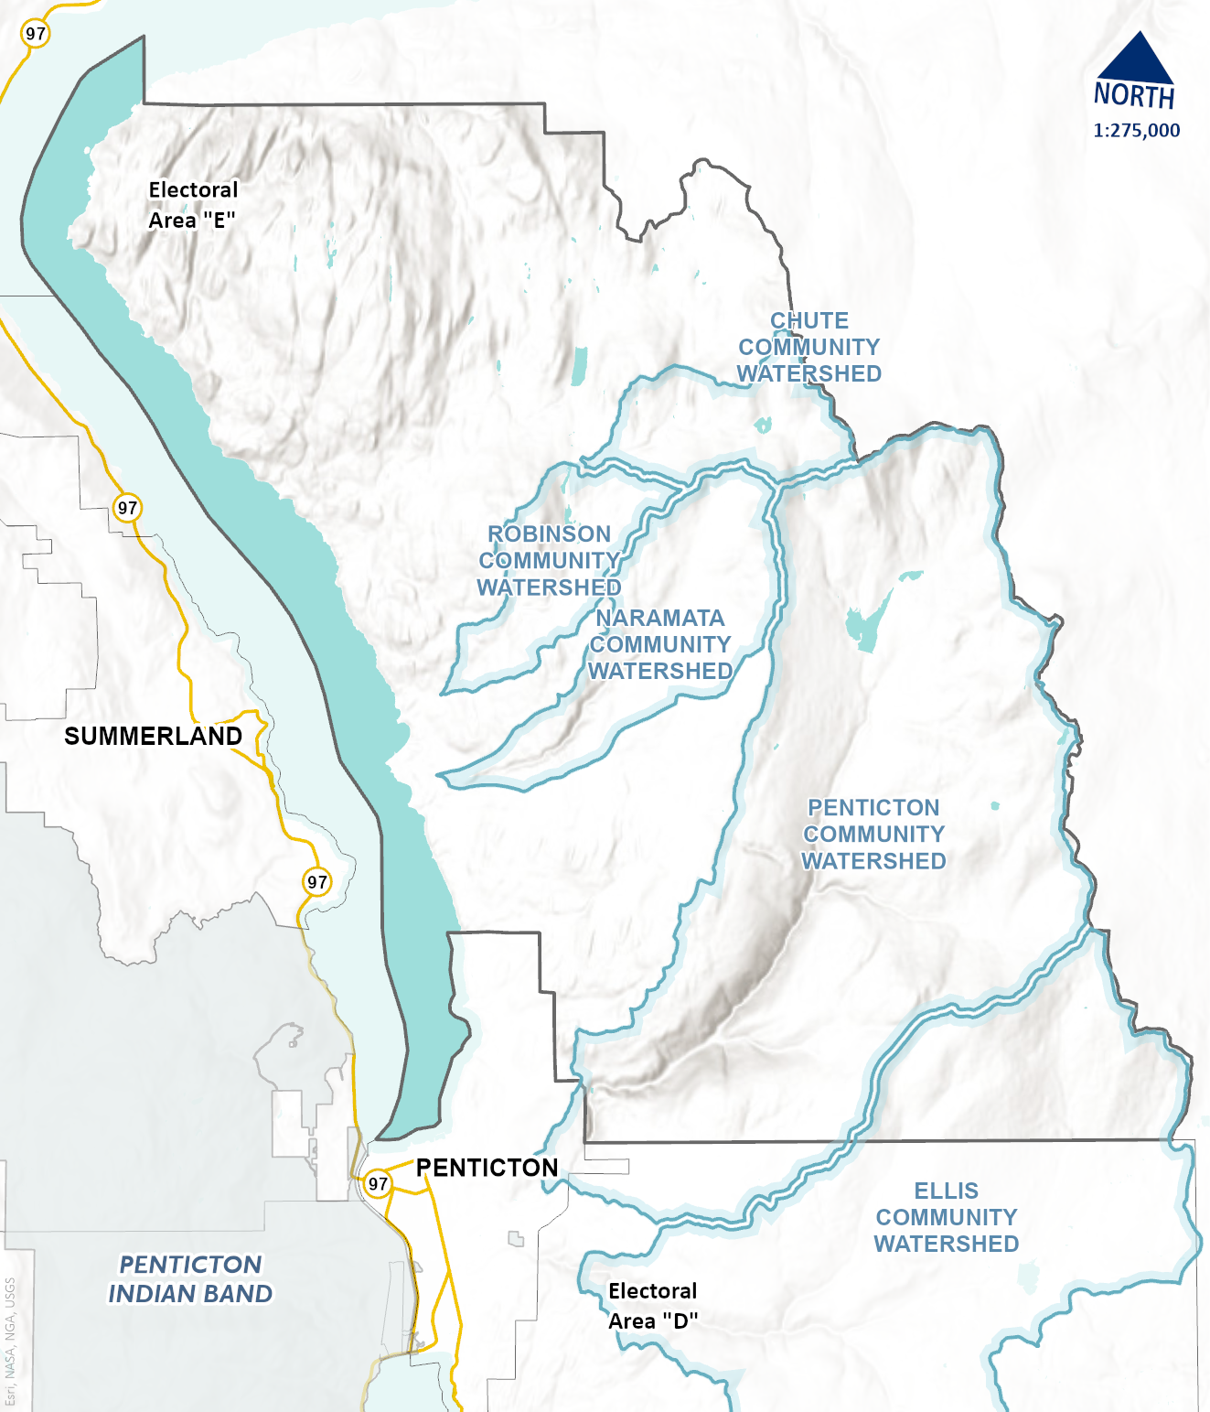
Resource Area (RA)
Designation of community watersheds and subsequent Zoning amendments adding a Watershed Resource Area (WRA)
Encourages energy production form renewable resources

Slide 16
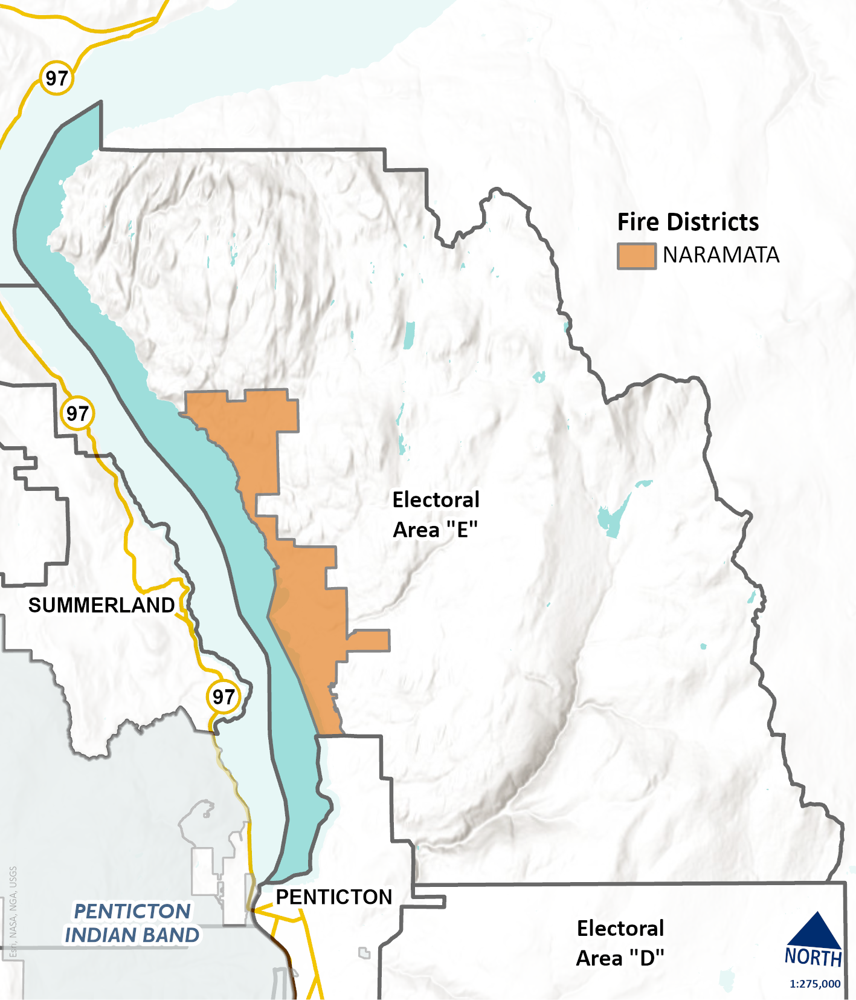
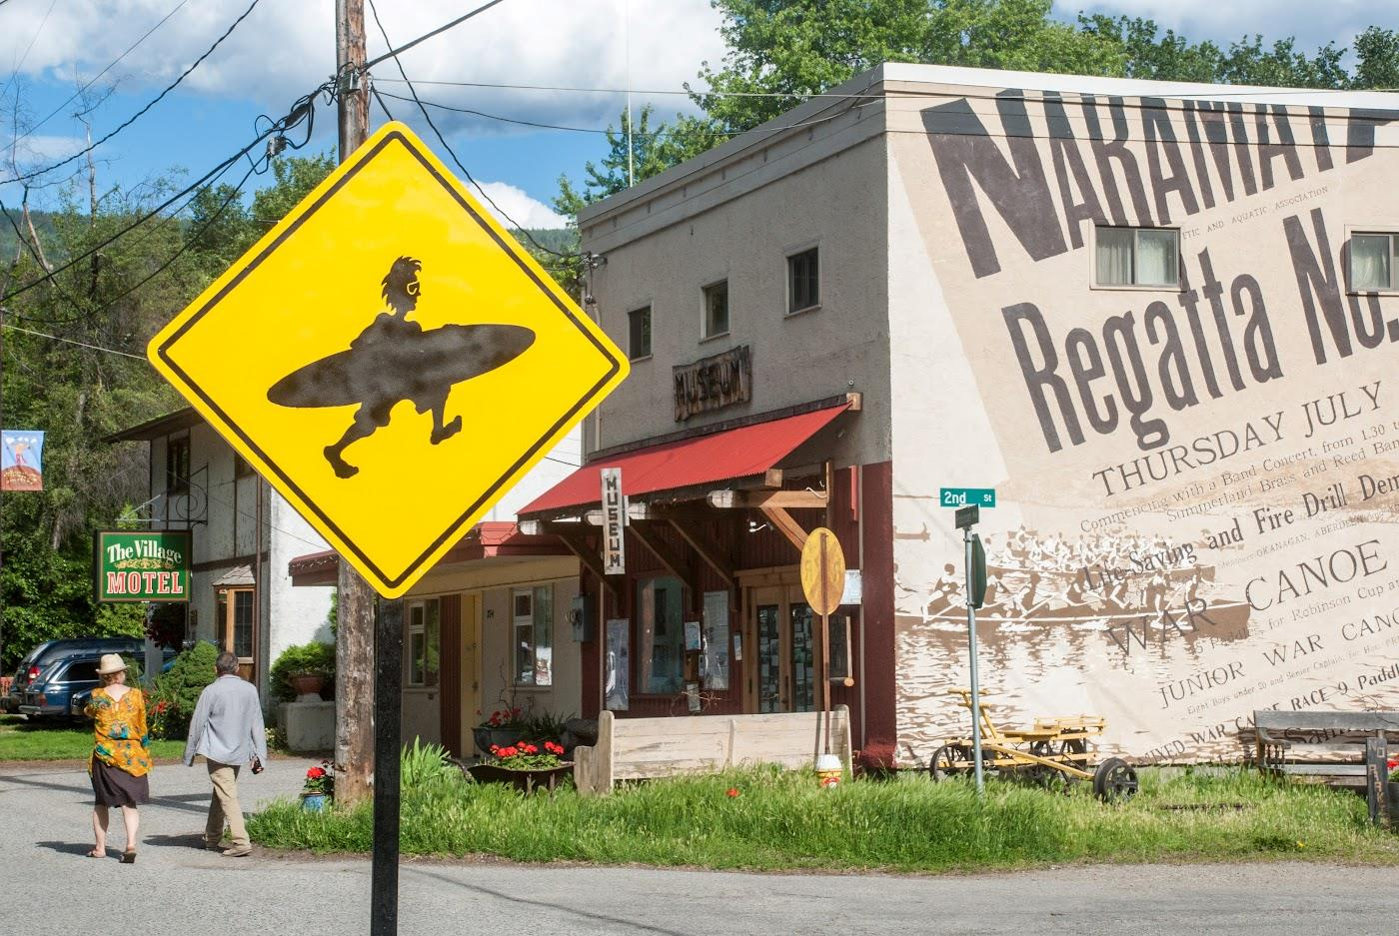
Administrative, Cultural and Institutional
Updated Fire District map
Updated Heritage and cultural values
New Social Well-Being section

Slide 17
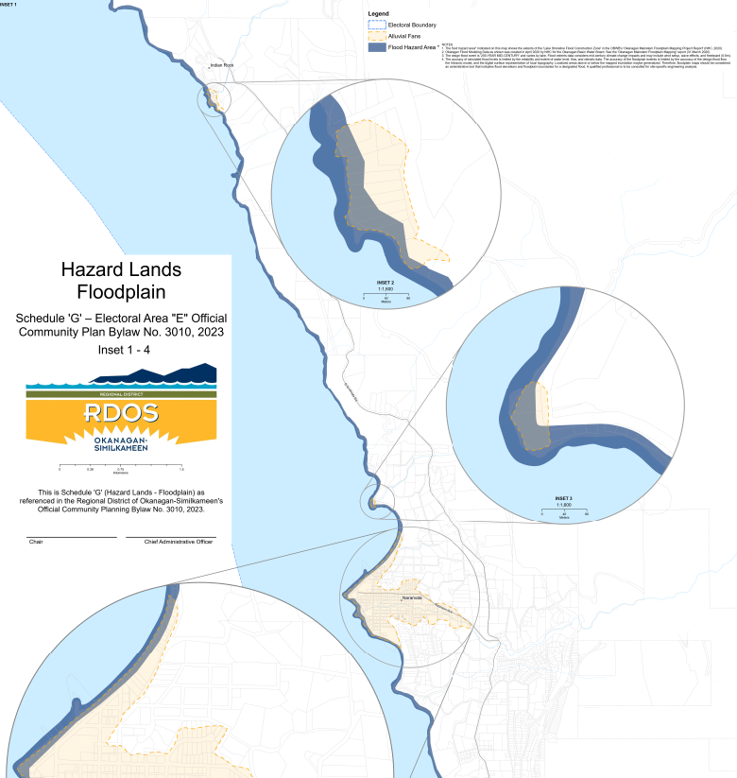
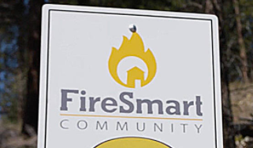
Natural Hazards
Updated sections for geotechnical hazards, wildfire, and flooding
OBWB flood mapping data
Provincial Alluvial fan study (1994)

Slide 18
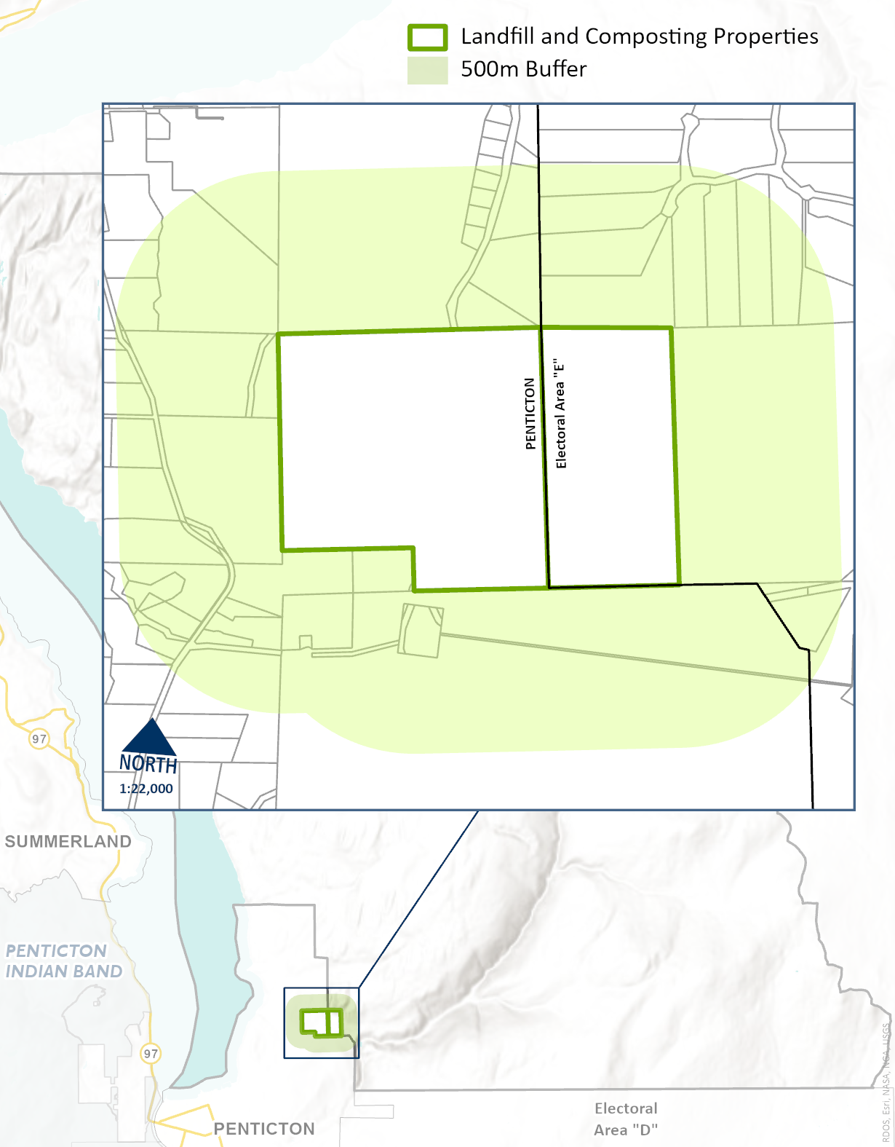
Community Infrastructure
Amalgamates transportation, community water and sewer systems, storm water, street lighting, and solid waste management
Acknowledges Naramata’s desire to become an International Dark Sky community
Shows 500 m buffer zone discouraging sensitive development

Slide 19

Climate Change Mitigation and Adaptation
Data from 2020 Climate Change for the Okanagan Region
3 main objectives:
  Reduce GHG
  Achieve carbon neutral for RDOS operations
  Support climate change adaptation and mitigation efforts

Slide 20
Electoral Area “E” draft OCP Bylaw
Directions from P&D Committee June 1, 2023
Vacation Rentals: defer until regional review
Hillside Development: potential action item for hillside and other hazardous conditions
Growth Management: confirmed layered approach
Climate Action DP: not to introduce a GHG DP

Slide 21
Community conversations
Community Conversation Recommendations | Draft OCP
Future Growth direction | Layered approach in OCP
Gentle Infill | Layered approach in OCP
No new hillside residential developments | ‘Upper’ Naramata policies
Tree cutting Bylaw | Implementation action item choice
GHG reduction, building and retrofitting | Climate Action policies
Using renewable energy resources | RA policy
Signage Bylaw | In current Zoning Bylaw
Noise Bylaw | Have in Electoral Area “E”
More secondary suites/accessory dwellings | Already permitted (with servicing requirements)
Dark sky designation | Policy supporting this

Slide 22
Community conversations
Trail connections and expansion | In new ‘Game Plan’
Additional hotel capacity in village | Policy added
Community/social values | Added Social Well-Being section & Local Area Policies
Encourage energy efficient projects | RDOS Community Services being done
Building Step Code | Mandatory. BO’s see current type of buildings

Slide 23
Potential implementation priorities
Bring to community to prioritize Board Projects:
  Support the community to achieve an international Dark Sky recognition (19.6.4.8)
  Explore hillside development regulations (7.3.1.8)
  Housing needs and demand study (6.5.14)
  Explore lowering SFD height in lower Naramata (7.2.1.3)

Slide 24
Potential implementation priorities
Bring to community to prioritize
Advocacy:
  Supports the Prov extending speculations and vacancy tax to RDOS (6.5.12)
  Support Province to review STR including new compliance and enforcement (6.5.13)
  Support sale/donation of parcels along creeks to protect riparian area (7.2.1.5)
  Encourage Province to provide RDs with authority for tree protection 7.2.1.7)
  Encourage MOTI to: (7.2.1.8)
    Reduce speed limit within village
    Install speed calming strategies
    Address undeveloped road ROWs
    Install permeable walkways

Slide 25
Potential implementation priorities
Bring to community to priortize (continued)
Advocacy:
  6) Showcase heritage values to encourage econ dev opportunities (7.2.1.9)
  7) Encourage MOTI to review traffic movements and safety (7.3.1.3)
  Encourage MOTI to support landscaping along Robinson Ave btn 1st and 4th (12.3.7)
  Encourage MOTI to comply with signage reg’s within ROWs (13.3.7)
  Support a review of RDOS bylaw enforcement services (15.3.2.4)
  Encourage further studies on Radon gas, educate, and mitigate impacts 18.3.4,5,6)
  Supports working with IHA to educate on health impacts and climate change (21.3.14)

Slide 26
Potential implementation priorities
  What is missing?
  What could be deleted?

Slide 27
Next Steps
  Referrals to agencies (done)
  Meet with Community Advisory Group (June 29nd )
  Final round of community engagement (end of July?)
  1st and 2nd Reading (~ August)

Slide 28
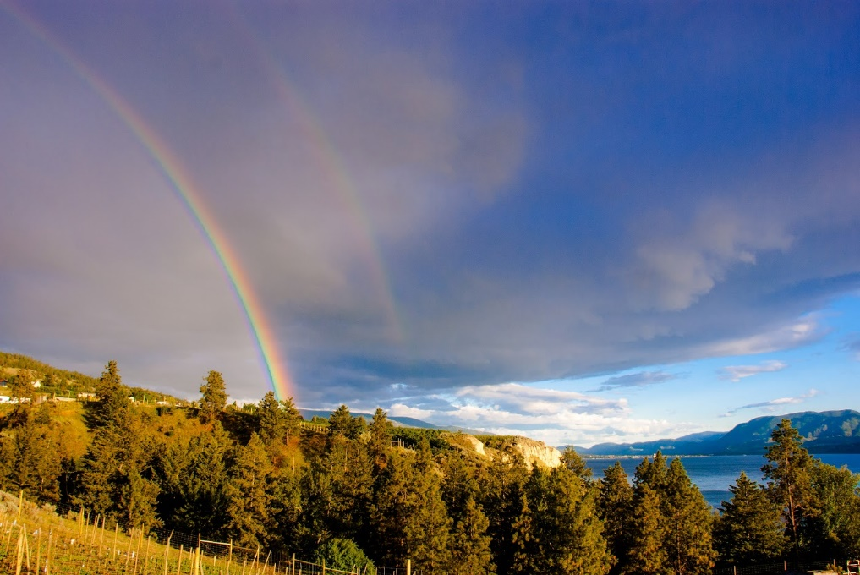
Electoral Area “E” draft OCP Bylaw
Thank you
Questions?

